Slide 1
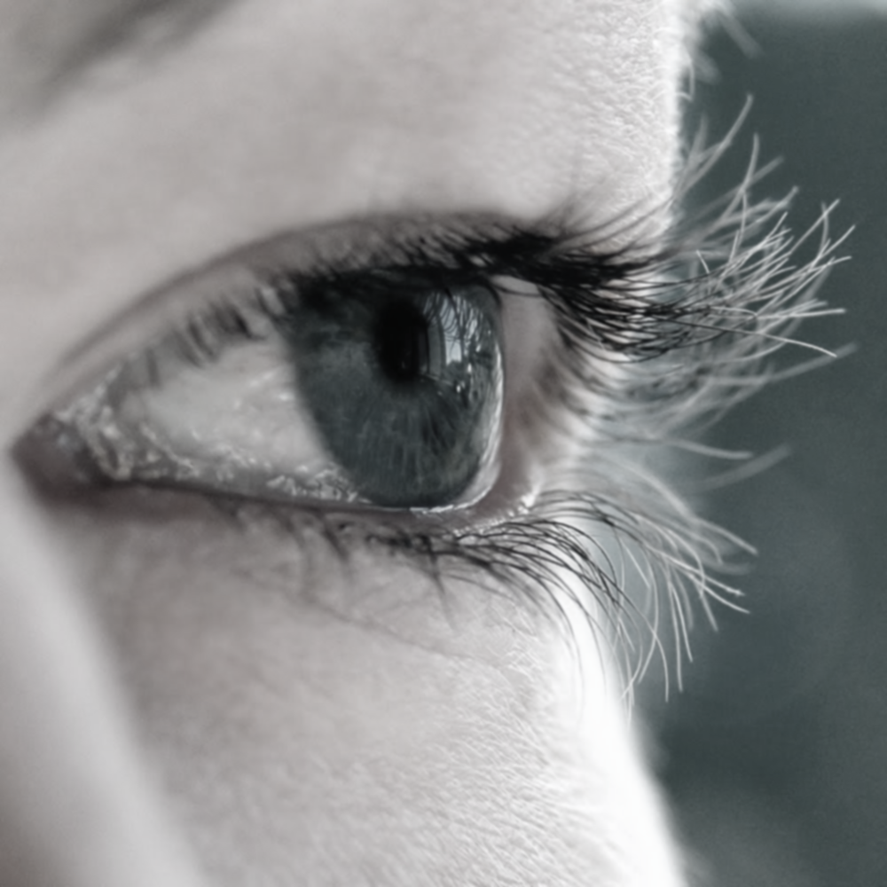
AUTOMATIC DETECTION OF DIABETIC RETINOPATHY
SUBMITTED BY:
Parikshit Saha (Roll No- 08102003015)
Deepanjan Biswas (Roll No- 08102003020)
Subhadip Basunia (Roll No- 08102003021)
Rabin Banerjee (Roll No- 08102003049)
Under Guidance of
Prof. H.S.Dutta

Slide 2
DIABETIC RETINOPATHY
What is Diabetic Retinopathy?
♦ Diabetic Retinopathy, abbreviated as DR, is the effect of Diabetics on eye which may lead to blindness in its furthermost stage.
♦ Symptoms some patient include maybe blurred vision, certain loss of vision, smoke globes or specks that float in front of the eye.
Notes:
Overall one may not have experience about any symptoms. Retina
screening may pick up early warning in the science of which we are unaware. This is the main reason
of why it is so important to attend regular screening appointments without any experience
of the symptoms.

Slide 3
Motivation
What’s the effect of it now a days?
♦ Diabetic is in its epidemic form now a days. All patients with diabetes mellitus will have a higher risk of being diagnosed with diabetic retinopathy. In Singapore & India like third world countries, 22% of patients are diagnosed with diabetic retinopathy and half of this affected patients had severe sight-threatening diseases.

Slide 4
BASIC EYE ANATOMY
Notes:
This is the basic anatomy of the eye. We all know that light comes through the lens & falls on the retina to make things outside of the world visible. Iris another main part of the eye used to control the light flow into the eye. Rod & cones cells presented in retina helps us to view & enjoy the scenes.

Slide 5
DIABETIC Retinopathy
Effect of diabetes on the eye is called Diabetic
Retinopathy (DR).
It can be mainly classified into three categories.
No Deterioration
Non-Proliferative or Background Diabetic Retinopathy (N-PDR or BDR)
Proliferative Diabetic Retinopathy (PDR)

Slide 6
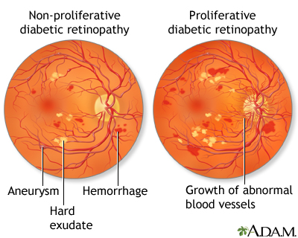
Background diabetic retinopathy
Earliest stage of DR
Blood vessels get weakened
Lead to dot like bleeding known as microaneurysm
No surgical operations are needed.
Monitoring & Controlling BP & BC
can be helpful.
Also known as Non-proliferative Diabetic Retinopathy (NPDR)

Slide 7
Proliferative DIABETIC Retinopathy
Circulation problem in the blood vessels
New fragile vessels developed
These self-developed vessels can
haemarage easily leading to blood
leaking into humour which causes floats
& decreases the quality of the vision.
In Maculopathy, macula is affected by exudates. Exudates generation too close to the macula damages the central vision & may lead to permanent loss of vision.
Notes:
Circulation problem in the blood vessels of the retina mean some areas don’t get enough oxygen. New fragile vessels formed to bring in this vessels oxygen. Since this new vessels are self-developed , they can haemarage easily leading to blood leaking to retina which causes floats & decreases the quality
of the vision. Laser will be used to shrink these.
Maculopathy & its effects are quite different. It effects the central part of the retina called the macula which is mainly responsible for the
sharp vision. This fluid is caused due to damaged blood vessels of the retina & is rich in fat & cholesterol. Over the eye re-absorbs the water easily. The fat & the cholesterol leaves behind as residue called as exudates. These are seen into the photograph as yellow blobs around the area of fluid leakage. If
the fluid accumulates too close to the center of the macula then the central vision maybe destroyed. If too much of the exudates accumulate around the macula then it may cause to permanent loss of central vision. To prevent this lasers are used by the ophthalmologists. If one can keep his/her Blood pressure & glucose level accordingly to as recommended by the doctor then he/she is less likely to be in such a problems.

Slide 8
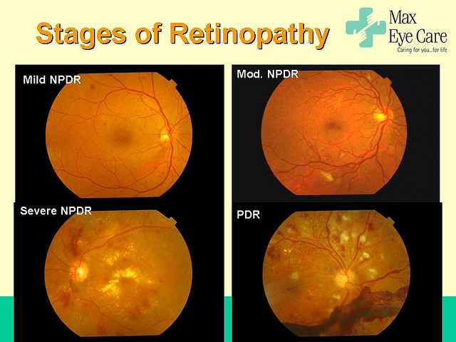

Slide 9
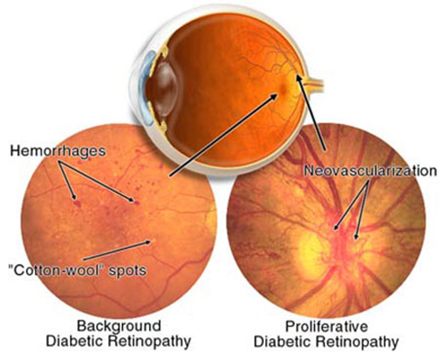
ABNORMALITIES ASSOCIATED WITH EYE
Microaneurysms
Haemorrhages
Hard Exudates
Soft Exudates
Neovascularization

Slide 10
Microaneurysms
Tiny, dark dot like red spots
Size ranges from 10-100
microns
Haemorrhages
Occurs in the deeper layers
Often called “Blot‟ because of its Circular in size.
Size larger than microaneurysms

Slide 11
HARD & SOFT EXUDAtes
Fluid rich in fat and protein contained in the eye leaks out.
Water gets absorbed leaving
the fat as residue.
Soft exudates are often called “cotton wool spots”
Seen into the photograph as yellow blobs

Slide 12
Neovascularization
The Abnormal growth of blood vessels in eye is termed as Neovascularization.
These growth around the pupil, glaucoma results in increasing
pressure within the eye.
Retinal Detachment:- These new blood vessels with weaker walls may cause scar tissue to grow that can pull the retina away from the back of the eye.

Slide 13
Image processing

Slide 14
What is an image?
We can think of an image as a function, f(x,y)
f( x, y ) gives the intensity at position ( x, y )
Realistically, we expect the image only to be defined over a rectangle, with a finite range:
f: [a,b]x[c,d] → [0,1]
A color image is just three functions pasted together. We can write this as a “vector-valued” function:
Notes:
As opposed to [0..255]

Slide 15
Image processing algorithms
♦ ADAPTIVE HISTOGRAM EQUILIZATION (CLAHE)
♦ MORPHOLOGICAL OPERTIONS:
► EROSION
► DILATION
► OPENING
► CLOSING

Slide 16
ADAPTIVE HISTOGRAM EQUILIZATION (CLAHE)
What is Adaptive Histogram Equalization ?
Adaptive histogram equalization (AHE) is a computer image processing technique used to improve contrast in images.
What is CLAHE ?
CLAHE differs from ordinary adaptive histogram equalization in its contrast limiting. This feature can also be applied to global histogram equalization .

Slide 17
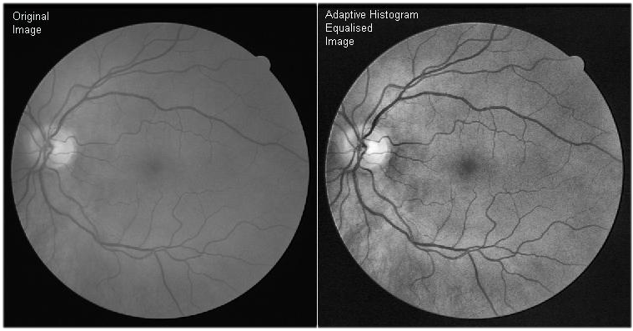
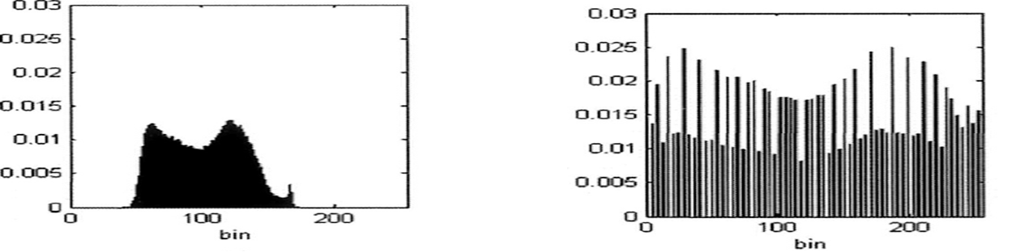
CLAHE result:

Slide 18
MORPHOLOGICAL OPERATIONS
EROSION: Erosion removes pixels on the object boundaries in the image by changing it to the background pixel. This shrinks the object and breaks up a single object.
DILATION: Dilation, on the other hand, adds pixels to the object boundaries by changing the background pixel surrounding it. This enlarges the object and Multiple objects could merge together as one.
OPENING: In opening, the image would undergo erosion followed by dilation. This removes the small object pixels before enlarging the remaining.

Slide 19
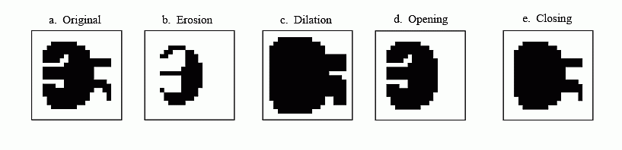
Closing: In Closing, the image would undergo dilation followed by erosion. This removes the small background pixels before enlarging the remaining. In this way, the contours of the object smoothen and small object gaps fused.
Segmentation: Image segmentation is used to locate the objects or boundaries in the image. In edge detection function, the contours of the objects are extracted from the image.
Example of Morphological operations

Slide 20
OUR AIM OF THE PROJECT
Blood vessels are extracted in this project for the identification of diabetic retinopathy. The amount of blood vessel area in DR affected eye is much higher than normal eye because of Neo-vascularization.
Affected
Normal

Slide 21
Stages of Blood vessel Detection
Fundus Image
(RGB)
Green Component
Intensity Inversion
Histogram
Equalization
Optical Disk Removal
Noise Removal
Border Removal
Blood vessel
area calculation
Image Segmentation

Slide 22
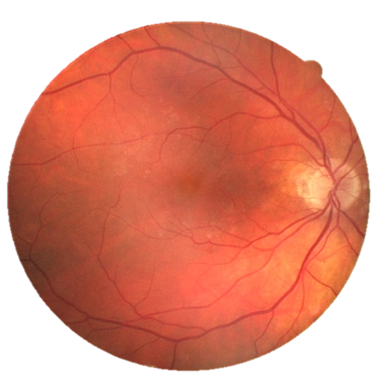
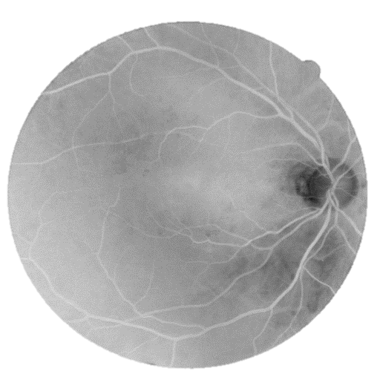
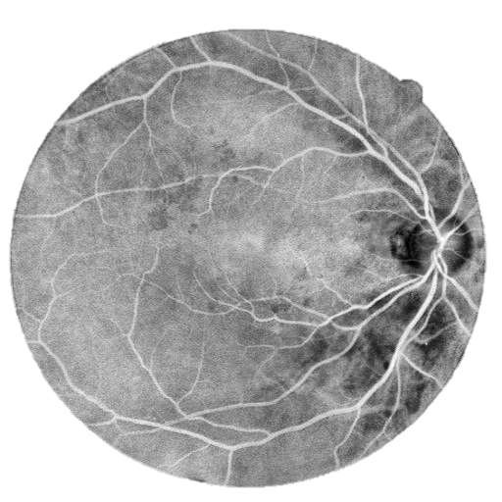
Intensity Inversion: ♦The intensity of the green channel of Fundus Image is inversed. ♦ Green channel is used as it is more efficient in the detection.
Histogram Equalization: ♦Contrast of the fundus image tends to be bright in the centre and
diminish at the side. ♦ To minimize this & have more uniform image contrast is
stretched by applying adaptive histogram equalization.
Fundus Image
Inversed Green Channel
CLAHE Output

Slide 23

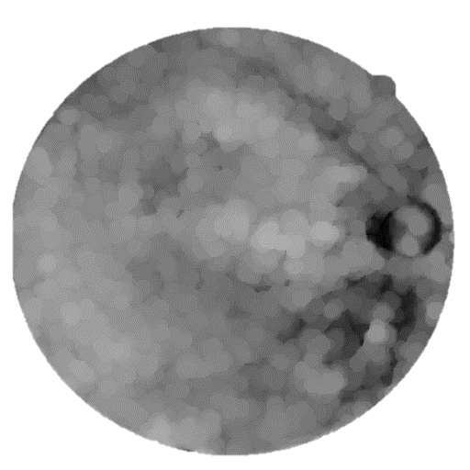
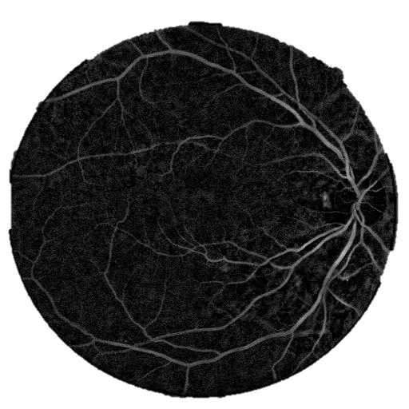
Optical Disk Removal: ♦ Optical disk is a black patch in the image. ♦ Erode function protects the small blood vessels by reducing their sizes while dilate function blows up the larger remaining details which are intended to be removed. ♦ Optical disk is then removed by Subtracting the resulting image from the CLAHE Output image.
Opening

Slide 24
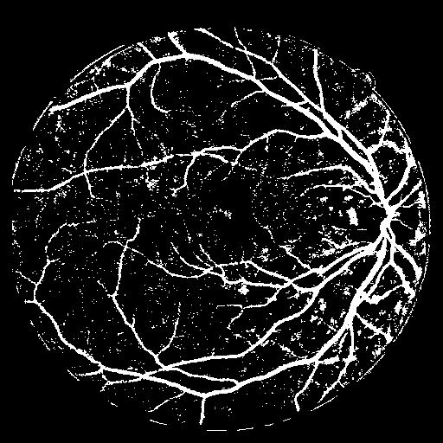
Image segmentation: ♦ Image segmentation is also the process of selecting of pixels that are similar in characteristics such as intensity & connectivity. ♦ Image segmentation is used to locate the boundaries of vessel in the Fundus image.

Slide 25
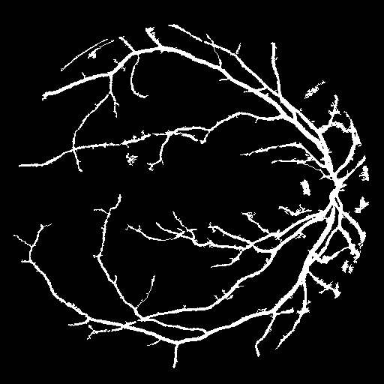
Noise Removal: ♦ After segmentation, the binary image becomes noisy.. ♦ We marked all connected clusters & calculate the pixel-area of the cluster. smaller than a particular value, considering them as noise. ♦ Pixel areas smaller than a particular threshold value are deleted, considering them as noise.

Slide 26


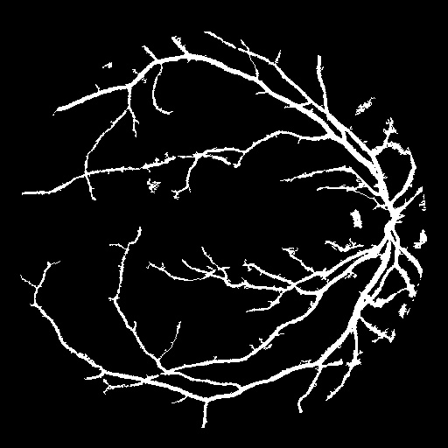
Border Removal: ♦ The Circular border creates some noise pixels. ♦ We used canny method to detect the edges & image filling is done to fill the region. ♦ The Circular border is obtained after subtracting the dilated image with the eroded image,which is subtracted from the noise removed image.
Blood vessel count ♦ The area of the blood vessels is obtained by using two loops to count
number of pixels with binary 1 (white) in the final blood vessel image.

Slide 27
MATLAB SIMULINK IMPLEMENTATION

Slide 28
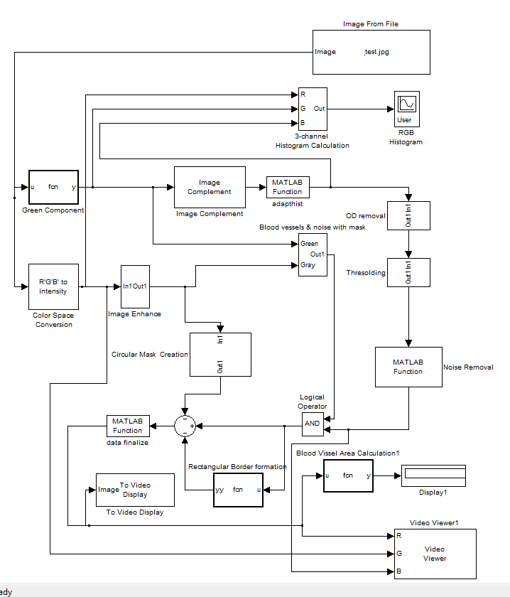
MATLAB IMPLEMENTAION MODEL

Slide 29
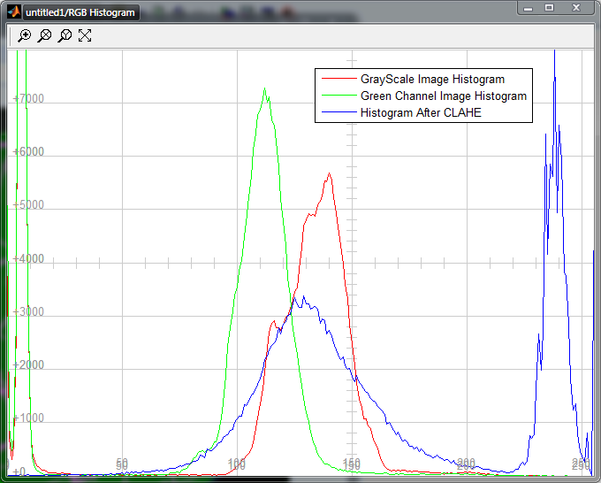
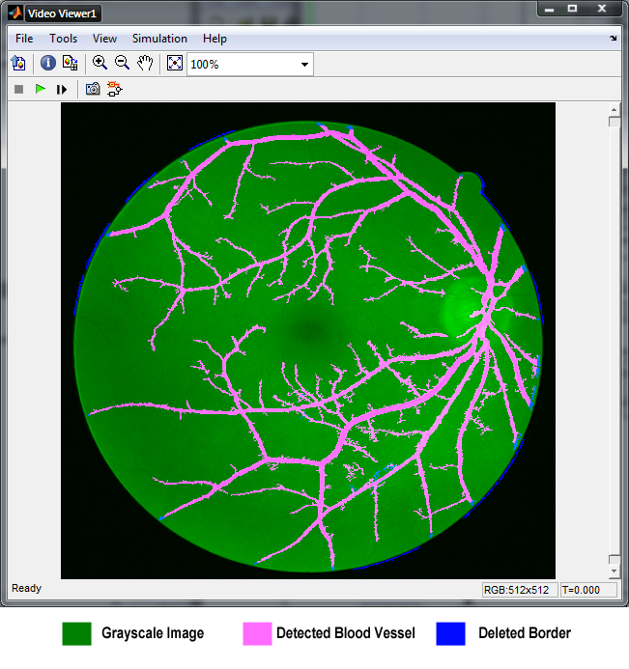
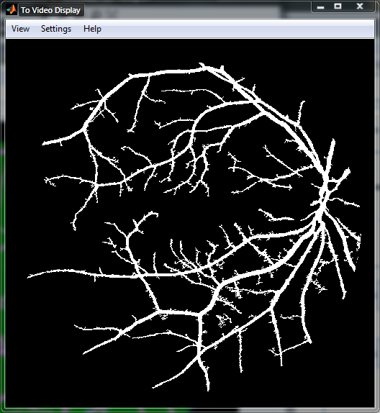
MATLAB SIMULINK RESULTS

Slide 30
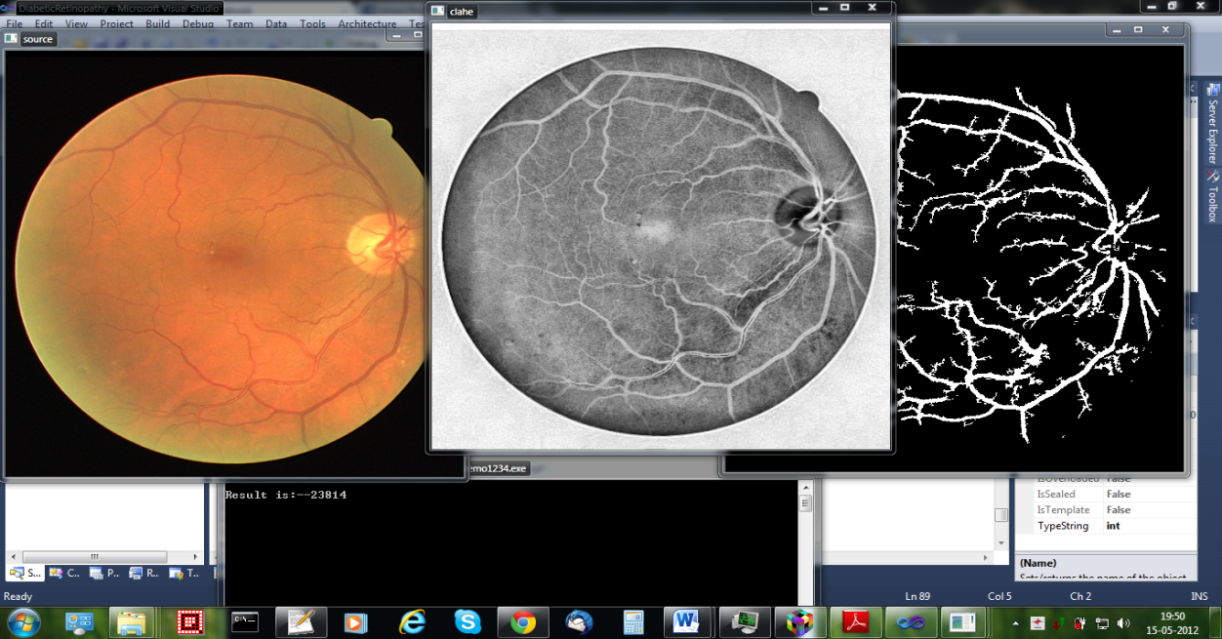
C IMPLEMENTATION RESULT

Slide 31
Hardware
IMPLEMENTATION

Slide 32
WHY DSP processor?
A DSP processor (C6000) is like a normal processor, optimized for faster floating point calculations to aid in signal processing.
Easily programmable using Code Composer Studio.
As Image Processing involves huge amount of data, debugging is a important issue while implementing algorithms.DSP serves this purpose well.

Slide 33
TMS320C6713 DSK
Digital signal processors such as the TMS320C6x (C6x) family of processors are like fast floating point special-purpose microprocessors with a specialized type of architecture and an instruction set appropriate for signal processing. Features of the C6713 include :
Capable of fetching eight 32-bit instructions every 1/(225 MHz) or 4.44 ns.
264 kB of internal memory (8kB as IPRAM and IDRAM Cache and 256kB as L2 memory(SDRAM) shared between program and data space.)
Eight functional or execution units composed of six arithmetic-logic units (ALUs) & Two multiplier units
A 32-bit address bus to address 4 GB (gigabytes)
Two sets of 32-bit general-purpose registers.

Slide 34
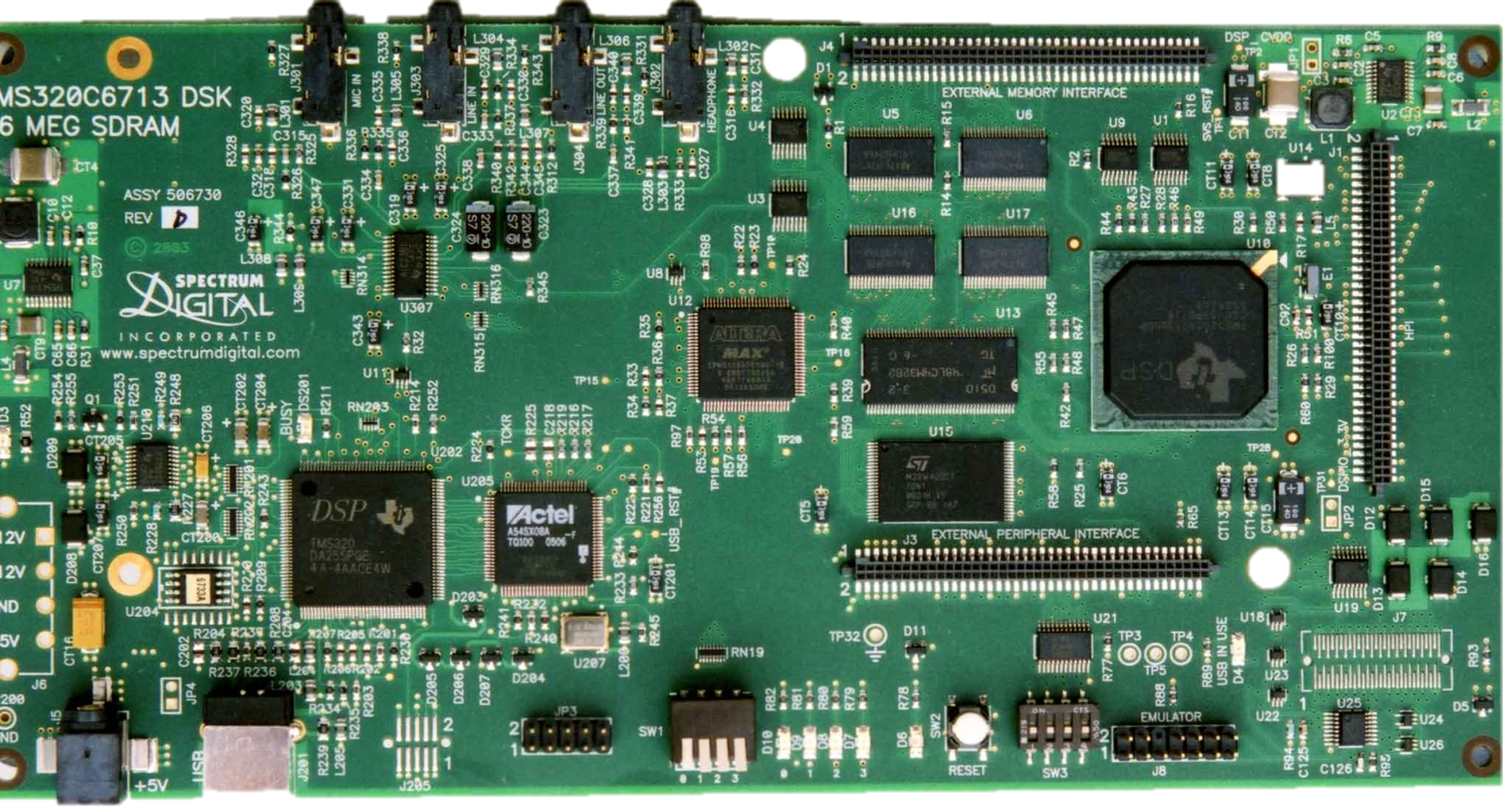
TMS320C6713 DSK HARDWARE
Mic In
Line In
Headphones
Expansion
C6713 CPU
Codec
+5V Supply
USB
JTAG
LEDs
RAM
Switches

Slide 35
Code composer studio
Code Composer Studio is an integrated development environment for developing Program for the TMS320 DSP processor family.
Code Composer Studio includes a real time operating system called DSP/BIOS.
It includes accurate instruction set simulators, and supports JTAG based debugging.
Notes:
Joint test action group=jtag..help in debugging

Slide 36
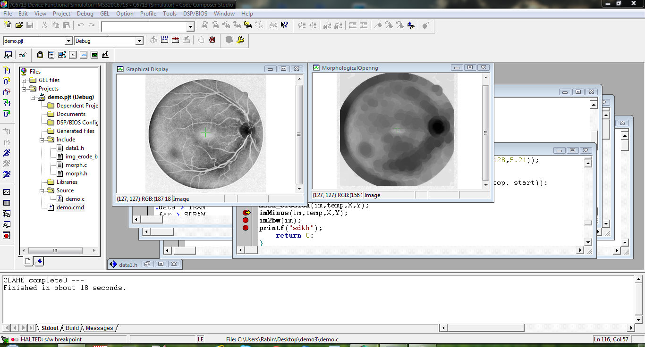
CODE COMPOSER STUDIO RESULT

Slide 37
Using Image on Program
1.using pragma directive
#pragma DATA_SECTION(img,"SDRAM");
unsigned char img[NPIX];
2.using far modifier
unsigned far char img[NPIX];
and making .far section in SDRAM in cmd linker.
Notes:
.vec: Interrupt vector table */
.text: /* Code */
.const /* Variables defined with const */
.bss: /* Global variables */
.data:
.STACK >> Stack (local variables) */
.FAR>> Variables defined with far */
.HEAP>>/* Heap: malloc, free, etc */
CINIT>>memory map reserved for constants and other data for the initialization of global C variables

Slide 38
Constraints of TMS320C6x
Lack of proper Documentation
Real-time transferring of image is a cumbersome task.
Image Processing Algorithms are at first developed using Matlab for easy debugging & then rewritten using C.This is more time consuming.

Slide 39
FUTURE WORK
MICROANEURYSMS & EXUDATE DETECTION
CODE OPTMAIZATION
COMPACT EMBEDDED SYSTEM

Slide 40
RESULT
♦ We took 40 Fundus images. Among which some
eyes are affected from different types of DR and
some are normal.
♦ We take the images as input & get the blood
vessel area as output.
♦ By knowing the types of DR of the images
previously we can easily understand the
corresponding Blood vessel area for that types of
DR.
Notes:
The criteria used for detecting image background based disease like exudates, microaneurysm and red
spots include Object Ratio Test, Compact Ratio Test, Length Test, Pixel Count Test
and Region Hole Test. After detecting and removing these background based
diseases, the image is then passed to the Vein-Processing stage for crossover points
detection using Modified Crosspoint Number Method (MCNM).

Slide 41
CONCLUSION
♦ The first phase of the work we have mainly highlighted the software based approach.
♦ For large scale diagnosis we need to develop a hardware based approach for the ease of detection.
♦ So in the second phase we concentrated in the hardware based system. We have done our project up to a stage which is successfully meeting hardware based system requirements.
♦ The achievements of this work include very good result in the diagnosis process. The results itself reflects the effectiveness of the hardware based implementation technique.

Slide 42
REFERENCE
Iqbal,M.I. et al, “Automatic Diagnosis Of Diabetic
Retinopathy Using Fundus Images”: By BlekingeInstitute
Of Technology Referenced October 2006.
Rulph Chassaing, Donald Reay; Digital Signal Processing and Applications With The TMS320C6713 And TMS320C6416 DSK; Wiley Interscience.
R.C.Gonzalez ,R.E.Woods; “Digital Image Processing” ;pearson
My Eye World: Eye Structure And Function. Referenced, August 2nd 2006, Website ; Http://www.myeyeworld.com/files/eye_structure.html

Slide 43


